Slide 1
Heterogeneity
Tabriz University of Medical Sciences Standard Workshop on Systematic Reviews
Presented by: Dr. Sakineh Mohammad-Alizadeh

Slide 2
Outline
what is heterogeneity?
identifying heterogeneity
causes of heterogeneity
dealing with heterogeneity
fixed and random effects meta-analysis

Slide 3
What is heterogeneity?
Heterogeneity is variation between the results of a set of studies

Slide 4
Identifying heterogeneity
graphically – the eyeball test
numerically – the I² test

Slide 5
Forest plot A
Forest plot B
Notes:
The eyeball test – look for lack of overlap in the confidence intervals
If studies are estimating the same thing we would expect confidence intervals to overlap to a large extent
statistical heterogeneity manifests itself in poor overlap of confidence intervals

Slide 6
Quantifying heterogeneity
I² describes the proportion of total variation across studies that is due to heterogeneity rather than chance
based on Cochran Q test and its degrees of freedom
I² = (Q – df) x 100% (df = the number of studies minus 1)
Q
Notes:
Note Q also referred to as the chi squared statistic, Q has low power with few studies and excessive power with many studies; this is why we have moved to using I squared.

Slide 7
Notes:
Notes: I squared of 20% means that 1/5 of the variability of the point estimates is due to heterogeneity rather than chance (or sampling error) because the studies are quite similar.

Slide 8
Quantifying heterogeneity
low values of I² indicate no, or little, heterogeneity
larger values of I² show increasing heterogeneity
roughly, values of of 25%, 50% and 75% correspond to low, moderate and high levels of heterogeneity (Higgins et al 2003, BMJ)
Notes:
Notes:
The actual value of I is independent of the number of studies.
You can calculate confidence intervals of I squared but this is not done in RevMan (but you can Google a STATA file written by Nicola Orsini called ‘heteroggi’

Slide 9
values of I²
0% to 40%: might not be important;
30% to 60%: may represent moderate heterogeneity*;
50% to 90%: may represent substantial heterogeneity*;
75% to 100%: considerable heterogeneity*.
Cochrane handbook

Slide 10
The importance of the observed value of I² depends on
(i) magnitude and direction of effects and
(ii) strength of evidence for heterogeneity (e.g. P value from the chi-squared test, or a confidence interval for I²).

Slide 11
Causes of heterogeneity: clinical
Differences between studies with respect to:
participants
conditions under investigation, eligibility criteria for trials, geographical variation
interventions
e.g. type of drug, intensity, dose, duration, mode of administration, experience of practitioners, nature of control (placebo, none, standard care)
outcomes
e.g. type, follow-up duration, ways of measuring outcomes, definition of an event

Slide 12
Causes of heterogeneity: methodological
Differences between studies with respect to:
design
e.g. randomized vs. non- randomized,
parallel group vs. crossover vs. cluster randomized,
length
conduct
e.g. allocation concealment, blinding, approach to analysis, imputation methods for missing data

Slide 13
Statistical heterogeneity
excessive variation in the results of studies above that expected by chance
Consequence of variation across studies is that they produce differences in results = statistical heterogeneity
Opposite to homogeneity, which is when there is an identical effect underlying every study
Notes:
Consequence of variation across studies is that they produce differences in results = statistical heterogeneity
Statistical heterogeneity is the variation in the true effects underlying the studies which may manifest in more ‘observed variation’ than expected by chance.
Opposite to homogeneity, which is when there is an identical effect underlying every study

Slide 14
Dealing with heterogeneity
Options available to you:
check the data
don’t pool studies
ignore heterogeneity: use fixed effect model
investigate reasons for heterogeneity
incorporate heterogeneity: use random effects model

Slide 15
Option 1: Check the data
Check extracted data
Check analyses of individual studies
Notes:
Check analyses of individual studies, especially cluster and cross-over trials. This is because their analysis may not have been appropriate

Slide 16
Option 2: Don’t pool studies
Notes:
However, some methodologists may argue that this is not a strong argument just because of heterogeneity – your reasons for pooling data to produce a combined estimate should be made on the basis that studies are sufficiently similar to combine.

Slide 17
Option 3: Ignore heterogeneity
Notes:
Ignore heterogeneity by pooling studies using a FIXED EFFECT method of meta-analysis. Some methodologists would argue that there is little justification for this approach.

Slide 18
Fixed effect model
Philosophy behind model:
there is one real value for the treatment effect
all trials are estimating this common treatment effect
Notes:
A fixed effect meta-analysis assumes homogeneity.

Slide 19
Fixed effect model
Random
error
assumes that all studies are evaluating the same treatment effect
i.e. if they were all infinitely large they’d produce an identical result
Result
Common
true effect
Notes:
It says that each estimate will miss the common (fixed) effect due to random (sampling) error because they are small studies.
If they were infinitely large, all studies would give the same effect that lies on the common effect.

Slide 20
Option 4: Investigating heterogeneity
as an objective of your review (should be pre-specified in your protocol)
to determine causes of unexpected statistical heterogeneity
note. post hoc investigations should be reported as such and are hypothesis-generating at best

Slide 21
Investigating heterogeneity: tools
subgroup analysis
get answers to secondary questions concerning subsets of participants or interventions
can yield spurious findings if not used carefully
meta-regression
examine relationship between treatment effect and a particular characteristic of the study (not patients)
not available in RevMan
individual patient data (IPD) meta-analysis
investigate patient-level characteristics
time consuming and expensive
Notes:
Notes:
Should you believe the results of subgroup analyses?
Was the analysis pre-specified or post hoc?
Are analyses looking at within study or between study relationships?
Is there indirect evidence?
Is the relationship clinically or practically meaningful?
Meta-regression investigates whether characteristics of studies may be associated with the size of effect
Practical advice:
Specify a small number of characteristics in advance
Ensure there is a scientific rationale for each
How many studies?
Typically 10
Software options: STATA, SAS, comprehensive MA, S-PLUS, WinBUGS, SPSS
Meta-regression is preferable to subgroup analyses

Slide 22
Option 5: Incorporate heterogeneity
Notes:
Incorporate heterogeneity by pooling studies using a RANDOM EFFECTS method of meta-analysis.
Random-effects MA suitable for unexplained heterogeneity

Slide 23
Random effects model
if heterogeneity cannot be explained by characteristics of the studies, it may be incorporated into the meta-analysis using the random-effects model
the true treatment effects underlying the studies are allowed to differ and are assumed to be distributed around a central (mean) value
weights are adjusted to account for both within-study and between-study variation

Slide 24
Random effects model
Random
error
the width of the bell shape reflects the amount of heterogeneity
Trial
specific
effect
True mean
effect
Notes:
We recognise that there are different study-specific effects (i.e. allow the true effects underlying the studies to differ)
We make an assumption that there is a normal distribution of study specific effects around a central (mean) value = which is the mean (random) effect.
We estimate the mean of these truths underlying all of the individual studies

Slide 25
Interpreting random effects meta-analyses
Random effects meta-analyses are...
identical to fixed effect analyses when there is no clear heterogeneity
similar to fixed effect meta-analyses but with wider confidence intervals when there is heterogeneity
different from fixed effect meta-analyses when there is publication bias (or funnel plot asymmetry)
random effects analyses give relatively more weight to smaller studies
Notes:
NOTES:
In random effects meta-analysis, the CI is wider because it is MORE DIFFICULT to estimate a mean effect than if you have a common true effect (fixed effect model)
Random effects MA gives more weight to small studies, thus if you have funnel plot asymmetry (missing studies) it will possibly make the intervention more beneficial than in the fixed effect meta-analysis (because small studies have more influence on the final pooled estimate – thus random effects is not a panacea)
Advice – where the results of the pooled estimates are different between fixed and random effects meta-analysis, neither are probably right.
If we say that heterogeneity if ineviatable then why have fixed effect meta-analysis? Well, FEMA is useful to check that there isn’t something funny going on with the data.
It would be advisable to do BOTH FE and RE meta-analysis but not present both in the figures (but as sensitivity analysis and quote results in the text

Slide 26
Fixed versus random effects
almost identical

Slide 27
Fixed versus random effects
similar, but wider CIs
Notes:
With random effects meta-analysis you still say that fixation is better than cast only, but you might add “on average” (the CI is wider because it is a bit more difficult to estimate a mean effect than if you have used the fixed effect model (assuming you have a common treatment effect underlying the studies)

Slide 28
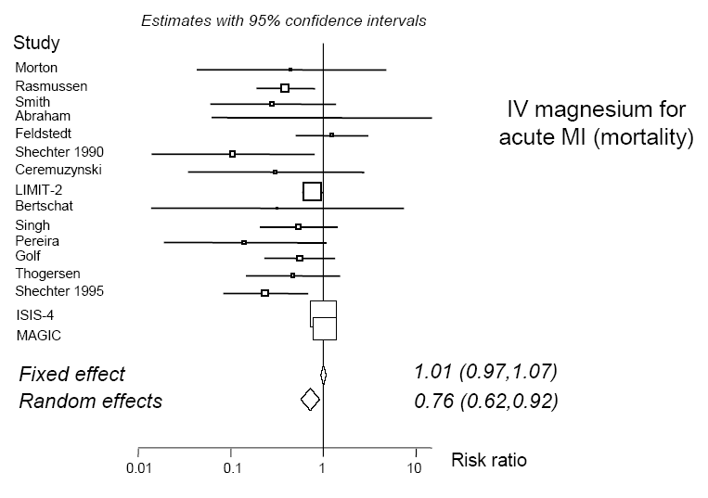
Fixed versus random effects
very different results
source: with thanks to Julian Higgins
Notes:
Funnel plot asymmetry – small sample bias – random effects meta-analysis gives relatively more weight to smaller studies
RE pooled estimate is the mean of the distribution of effects across studies. You can say “on average it works”

Slide 29
Take home messages
heterogeneity should be assessed and addressed
statistical heterogeneity occurs when studies are not all evaluating the same treatment effect
looking at overlap of confidence intervals on forest plot is a good way to identify statistical heterogeneity
I² can quantify the degree of inconsistency across studies

Slide 30
Take home messages
there are several options for dealing with heterogeneity
methods to investigate heterogeneity should be pre-specified in the protocol
random effects meta-analyses are useful for incorporating unexplained variability into a summary
but random effects meta-analyses are not a panacea

